Slide 1
Leadership and Management: Relationship and Differences
-Leadership and management often considered synonymous.
- It is essential to understand that leadership is an essential part of effective management.
- As a crucial component of management, remarkable leadership behavior stresses upon building an environment in which each and every employee develops and excels.
- Leadership is defined as the potential to influence and drive the group efforts towards the accomplishment of goals. This influence may originate from formal sources, such as that provided by acquisition of managerial position in an organization.
-A manager must have traits of a leader, i.e., he must possess leadership qualities. Leaders develop and begin strategies that build and sustain competitive advantage. Organizations require robust leadership and robust management for optimal organizational efficiency.
Relationship: Leadership and Management
Leadership is an important function of management which helps to maximize efficiency and to achieve organizational goals. The following points justify the importance of leadership in a concern.

Slide 2
Leadership and Management: Relationship and Differences Contd.
Differences between Leadership and Management
1. While managers lay down the structure and delegates authority and responsibility, leaders provides direction by developing the organizational vision and communicating it to the employees and inspiring them to achieve it.
2. While management includes focus on planning, organizing, staffing, directing and controlling; leadership is mainly a part of directing function of management. Leaders focus on listening, building relationships, teamwork, inspiring, motivating and persuading the followers.
3. While a leader gets his authority from his followers, a manager gets his authority by virtue of his position in the organization.
4. While managers follow the organization’s policies and procedure, the leaders follow their own instinct.
5. Management is more of science as the managers are exact, planned, standard, logical and more of mind. Leadership, on the other hand, is an art. In an organization, if the managers are required, then leaders are a must/essential.
While management deals with the technical dimension in an organization or the job content; leadership deals with the people aspect in an organization.

Slide 3
Leadership and Management: Relationship and Differences Contd.
Differences
Contd.
6. While management measures/evaluates people by their name, past records, present performance; leadership sees and evaluates individuals as having potential for things that can’t be measured, i.e., it deals with future and the performance of people if their potential is fully extracted.
7. If management is reactive, leadership is proactive.
8. Management is based more on written communication, while leadership is based more on verbal communication.
9. The organizations which are over managed and under-led do not perform upto the benchmark.
In Conclusion, leadership accompanied by management sets a new direction and makes efficient use of resources to achieve it. Both leadership and management are essential for individual as well as organizational success.
Leadership is about getting people to comprehend and believe in the vision you set for the company and to work with you on achieving your goals,
while management is more about administering and making sure the day-to-day activities are happening as they should

Slide 4
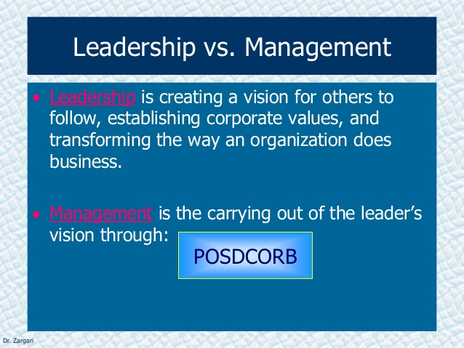
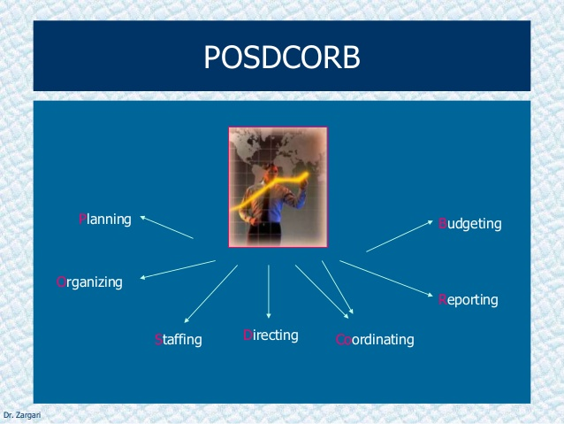

Slide 5
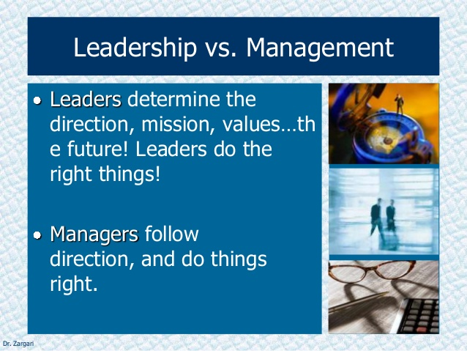

Slide 6
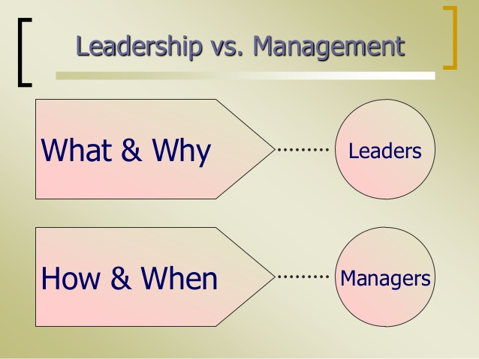

Slide 7
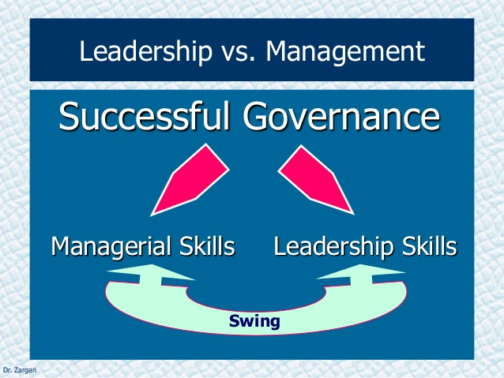

Slide 8
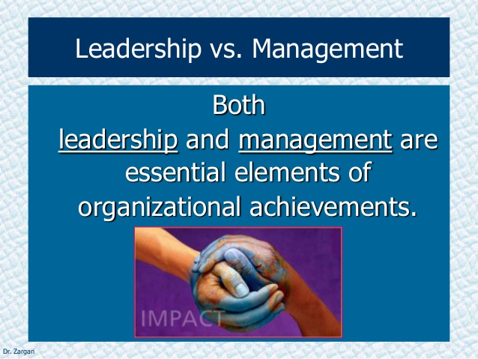

Slide 9
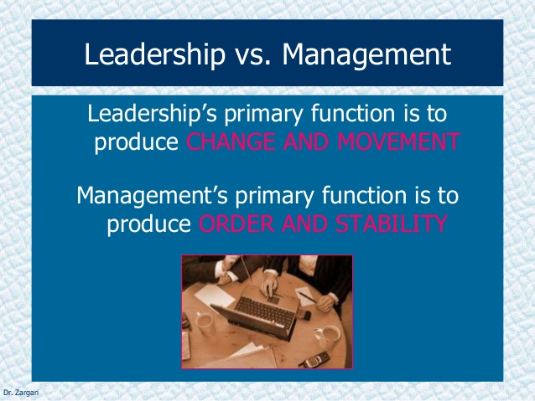

Slide 10
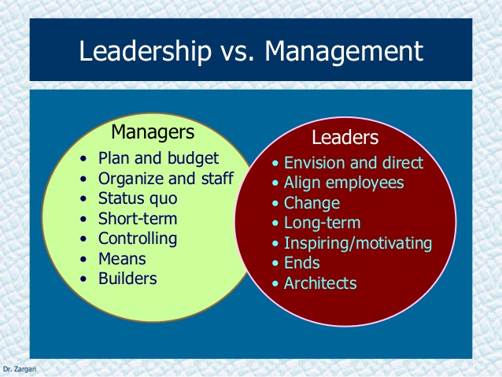

Slide 11
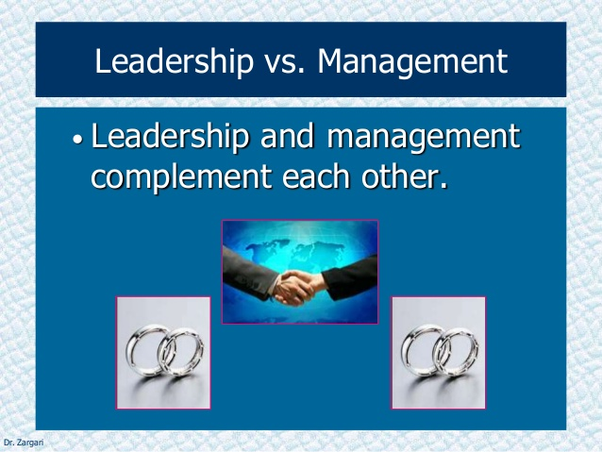

Slide 12
Organizational Leadership
Organizations need strong leadership for optimum effectiveness. Leadership, as we know, is a trait which is both inbuilt and can be acquired also.
Organizational leadership deals with both human psychology as well as expert tactics. Organizational leadership emphasizes on developing leadership skills and abilities that are relevant across the organizations.
An ideal organizational leader should not dominate over others.
He should guide the individuals under him, give them a sense of direction to achieve organizational goals successfully and should act responsibly.
He should be optimistic for sure.
He should be empathetic and should understand the need of the group members.
An organizational leader should not only lead others individually but also manage the actions of the group.

Slide 13
Organizational Leadership Contd.
Tips for Effective Organizational Leadership
-A leader must lead himself, only then he can lead others. He must be committed on personal and professional front, and must be responsible. He must be a role model for others and set an example for them.
-A leader must boost up the morale of the employees. He should motivate them well so that they are committed to the organization. He should be well acquainted with them, have concern for them and encourage them to take initiatives. This will result in more efficient and effective employees and ensure organizational success.
-A leader must work as a team. He should always support his team and respect them. He should not hurt any employee.
-A true leader should not be too bossy and should not consider him as the supreme authority. He should realize that he is part of the organization as a whole.
-Organizational leadership involves all the processes and possible results that lead to development and achievement of organizational goals. It includes employees’ involvement, genuineness, effective listening and strategic communication.

Slide 14
Qualities of Leadership
Leadership is the act of motivating other people toward a common goal. People that have leadership skills showcase a strong personality and interpersonal skills to lead others in their direction.
Leaders inspire others to follow a certain path in life. These leadership skills are important because human nature requires that certain people need to take charge and help others. Without leaders, it's very difficult to manage large groups of people, set unified goals, and make progress.
Leaders help their team and organization make progress and act in the right way. Good leaders should build a vision, set clear goals and directions, and map a dynamic path forward for their team or group.

Slide 15
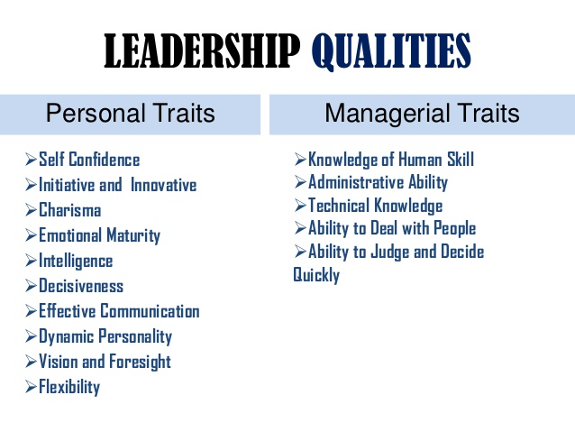

Slide 16
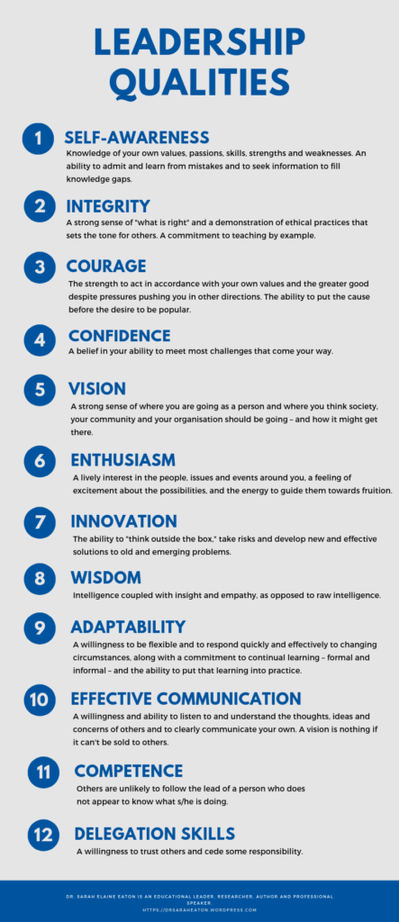

Slide 17
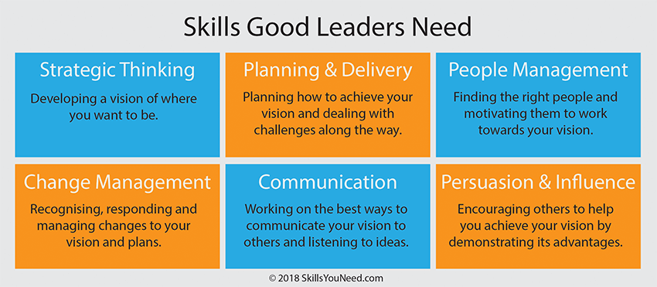

Slide 18
Factors affecting leadership styles
Leaders are able to influence and guide people under them, so an organization can become more effective in achieving its goals.
Styles of leadership are affected by different INTERNAL (like leader’s experience, personal value system, subordinates confidence, etc.) and EXTERNAL factors( such as the organizational environment, demographics, staff characteristics, resources, economic and political factors, technology and the culture of the organization) B

Slide 19
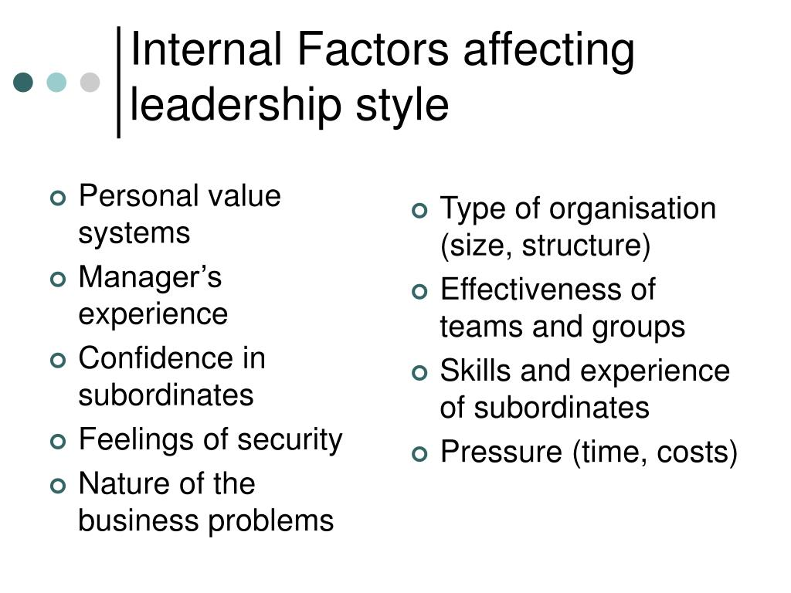
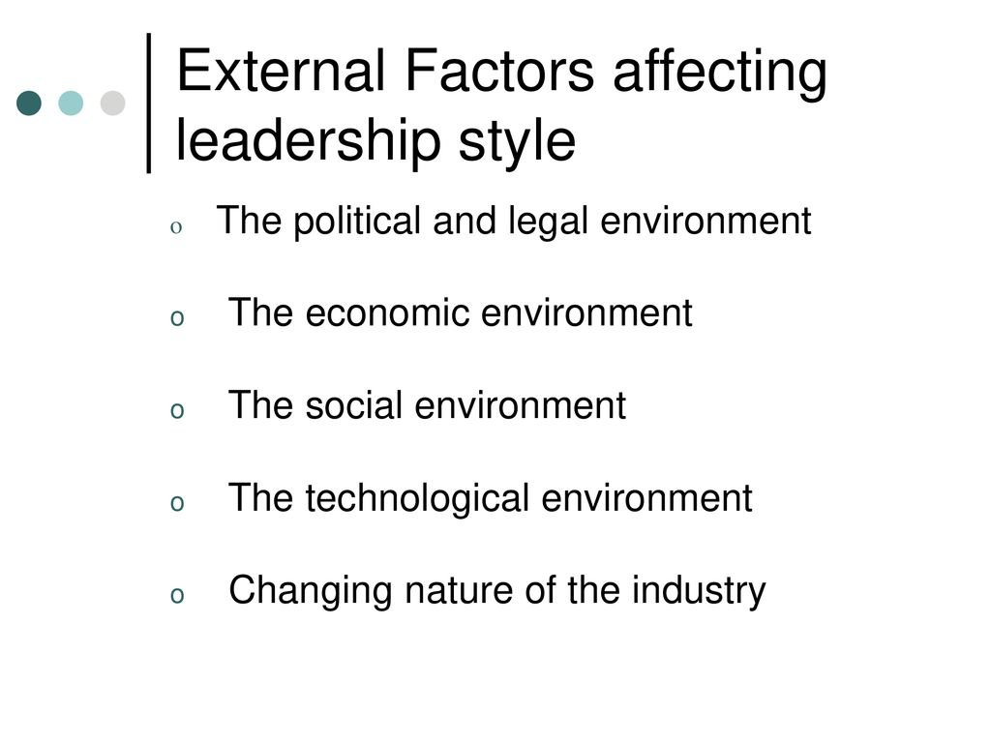

Slide 20
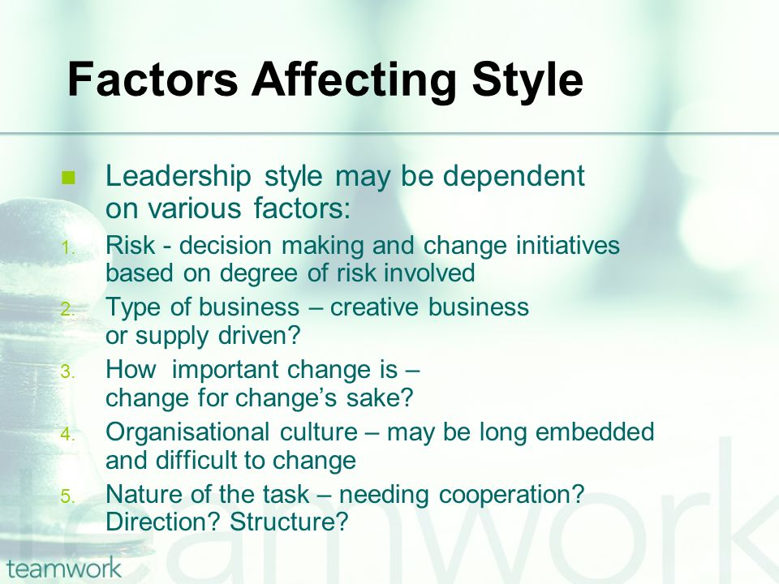

Slide 21
